Slide 1
Inspiring and Engaging Students Through Project-Based Learning and Design Thinking
goo.gl/jTwvh4

Slide 2
Our Shared Vision
Sharon Murchie 11th and 12th ELA Bath High School Bath, MI smurchie@bathschools.net ​@smurchies | Janet Neyer 9th and 12th ELA Cadillac High School Cadillac, MI ​janet.neyer@cadillac.k12.mi.us @janetneyer | Shannon Waite Creative Writing and 10th ELA Benjamin Carson High School of Science and Medicine Detroit, MI shannon.waite@detroitk12.org

Slide 3
Notes:
Moonshot video - Sharon

Slide 4
What bothers you?
answergarden.ch/358874
Notes:
Shannon - participant question

Slide 5
How do we inspire students to ask these questions?
Notes:
Sharon

Slide 6
Our Shared Vision
We believe that student choice creates opportunities for authentic learning, while still meeting the standards. These are some ways that we have included student choice and built authenticity into our core classes.
Genius Hour -- Project-Based Learning -- Design Thinking
Notes:
Sharon

Slide 7
Genius Hour
Notes:
Sharon

Slide 8
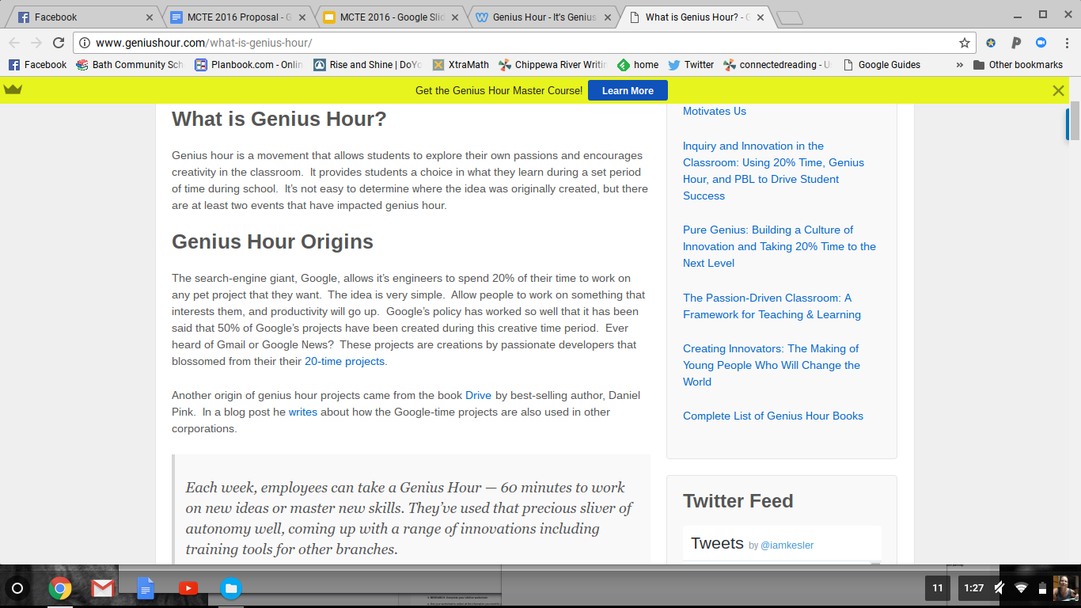
A complex idea can be conveyed with just a single still image, namely making it possible to absorb large amounts of data quickly.
Notes:
Sharon

Slide 9
I can:
Give students choice and freedom
Teach many of the research, research writing, and informational text standards
Have thoughtful conversations with the entire class about bias and source reliability
Conference with every student individually, every week
Make the assignments 100% relevant to students’ lives and interests
Have them publish what they create for an authentic audience
Students can:
Research whatever they are interested in
Show mastery of many of the standards related to research, research writing, and information text
Think critically about source bias and source reliability
Talk with me every week about what they are researching and about what they want to learn
See the value of these skills in everyday life
Join the conversation online about their passions and interests
Notes:
Sharon

Slide 10
Step 1:
Students research 1 day a week on whatever interests them
Step 2:
Students fill out a weekly form and submit it to me in Google Classroom
THEN, I read it, leave comments, and return it to students
Notes:
Sharon

Slide 11
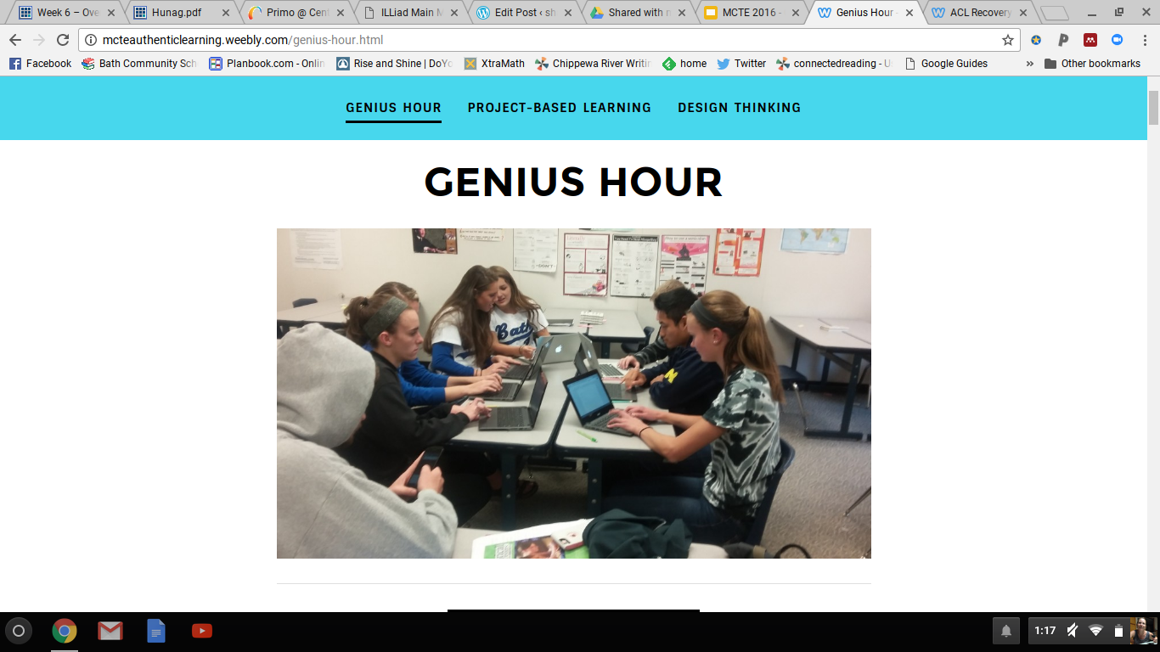

Slide 12
​Weekly Form
Name: __________________________
WEEK # _________
Date submitted: __________________
Today, I researched:
I read these articles (link them):
I read these because:
I learned:
This information supported/changed/pushed/contradicted my thinking in this way:
After reading these articles, I want to know more about:
I am thinking about focusing my research project on… because… I want to figure out….
Notes:
Sharon

Slide 13
Step 3:
Students begin to narrow their focus and determine what they want to create
“What did you want to find when you started researching? Create the thing you wished you’d found.”
Step 4: Students determine the MMAPS of what they want to create and start working on their project for publication
Notes:
Sharon

Slide 14
Notes:
Sharon

Slide 15
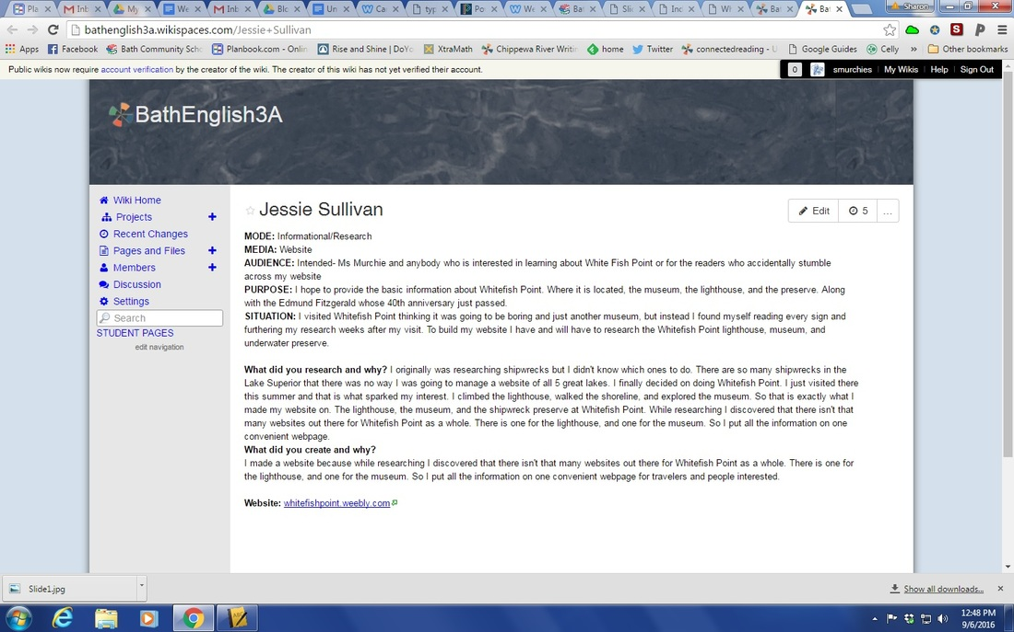
Notes:
Sharon

Slide 16
Step 5:
Students create a source document for their research (or AB)
Source Document
(foundation assignment for Annotated Bibliography)
​
Genius Hour -- Source Document Name: _______________________
Source #1
paste APA citation below:
What is the mode (genre) of this source?
Short summary of info found at this webpage:
How might you use this information in your project?
What bias is present in this source? What is the ideology?
Notes:
Sharon

Slide 17
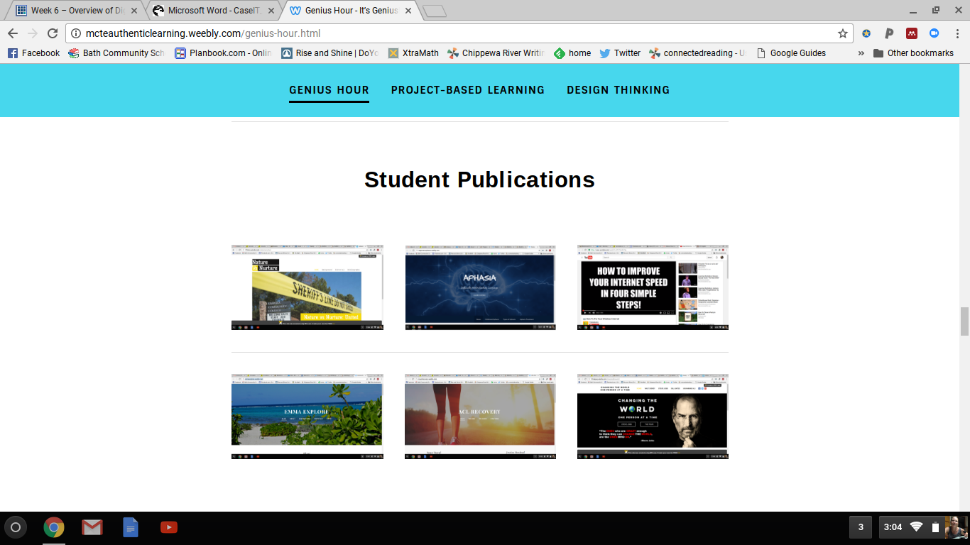
Step 6:
Students publish what they have created
http://myaclrecovery.weebly.com/
Notes:
Sharon

Slide 18
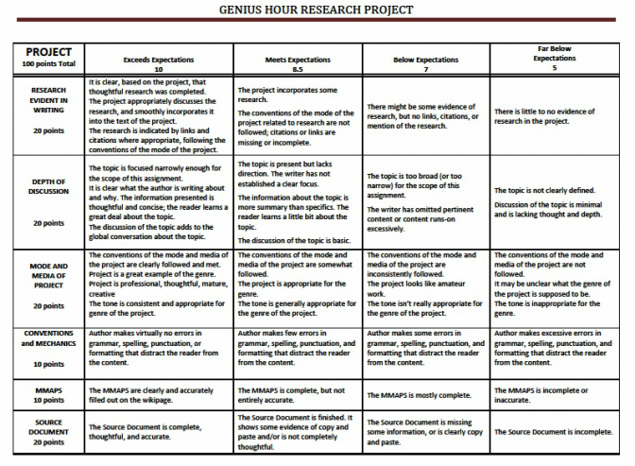
Step 7:
Sharing and Assessment of Student Publications
Notes:
Sharon

Slide 19
11-12.RI.5 Analyze and evaluate the effectiveness of the structure an author uses in his or her exposition or argument, including whether the structure makes points clear, convincing, and engaging.
11-12.RI.7 Integrate and evaluate multiple sources of information presented in different media or formats (e.g., visually, quantitatively) as well as in words in order to address a question or solve a problem.
​11-12.W.2 Write informative/explanatory texts to examine and convey complex ideas, concepts, and information clearly and accurately through the effective selection, organization, and analysis of content.
11-12.W.2a Introduce a topic; organize complex ideas, concepts, and information so that each new element builds on that which precedes it to create a unified whole; include formatting (e.g., headings), graphics (e.g., figures, tables), and multimedia when useful to aiding comprehension.
11-12.W.2b Develop the topic thoroughly by selecting the most significant and relevant facts, extended definitions, concrete details, quotations, or other information and examples appropriate to the audience's knowledge of the topic.
11-12.W.2c Use appropriate and varied transitions and syntax to link the major sections of the text, create cohesion, and clarify the relationships among complex ideas and concepts.
11-12.W.2e Establish and maintain a formal style and objective tone while attending to the norms and conventions of the discipline in which they are writing.
11-12.W.4 Produce clear and coherent writing in which the development, organization, and style are appropriate to task, purpose, and audience. (Grade-specific expectations for writing types are defined in standards 1-3 above.)
11-12.W.5 Develop and strengthen writing as needed by planning, revising, editing, rewriting, or trying a new approach, focusing on addressing what is most significant for a specific purpose and audience. (Editing for conventions should demonstrate command of Language standards 1-3 up to and including grades 11-12.)
11-12.W.6 Use technology, including the Internet, to produce, publish, and update individual or shared writing products in response to ongoing feedback, including new arguments or information.
11-12.W.7 Conduct short as well as more sustained research projects to answer a question (including a self-generated question) or solve a problem; narrow or broaden the inquiry when appropriate; synthesize multiple sources on the subject, demonstrating understanding of the subject under investigation.
11-12.W.8 Gather relevant information from multiple authoritative print and digital sources, using advanced searches effectively; assess the strengths and limitations of each source in terms of the task, purpose, and audience; integrate information into the text selectively to maintain the flow of ideas, avoiding plagiarism and overreliance on any one source and following a standard format for citation.
11-12.W.9 Draw evidence from literary or informational texts to support analysis, reflection, and research.
11-12.W.10 Write routinely over extended time frames (time for research, reflection, and revision) and shorter time frames (a single sitting or a day or two) for a range of tasks, purposes, and audiences.
ELA Common Core State Standards 11-12
Notes:
Sharon

Slide 20
Project-Based Learning
Notes:
Sharon

Slide 21
I can:
Understand PBL
Create my own essential question, project, and PBL unit
Give students choice and freedom
Teach units that bring in various texts (fiction, non fiction, poetry, etc.)
Teach units that allows diversity through connecting themes
Integrate reading, writing, and community
Have them publish what they create for an authentic audience
Students can:
Read diverse texts
Discuss texts in relation to real life and authentic topics
Make choices in their writings so that the topics relate to their experiences
Write a variety of text types (essays, poems, short stories, etc.)
Edit and revise their writings
Collaboratively discuss important topics
Notes:
Sharon

Slide 22
Step 1:
Essential Questions

Slide 23
What is it?
Essential Questions help keep a unit glued together.
It connects standards to content and knowledge that make the subject relevant to students' lives.
It helps drive the instruction so that the materials all relate to each other.

Slide 24
Example EQs
· What are the positive and negative aspects of both chaos and order?
· How do we form and shape our identities?
· In a culture where we are bombarded with ideas and images of “what we should be,” how does one form an identity that remains true and authentic for her/himself?
· What is creativity and what is its importance for the individual / the culture?
· Is humankind inherently good or evil?

Slide 25
MY EQ:
What is freedom?

Slide 26
Step 2:
Plan the Project

Slide 27
The beginning steps
Take into account:
Your students will use everything they learned in this unit to help answer the question with this product as a result
Standards should drive your teaching to accomplish this project

Slide 28
Project Ideas
Think about your essential question, what you're reading, what you're writing, and what standards you need to cover.
This will help you determine a project.
Advertisements
Social Media Campaigns
Blogs
Publications (of writing: stories, poems, essays, songs, etc.)
Public Service Announcements
Bookmarks
Brochures
Websites

Slide 29
Make the Project Authentic
Can you work with a community partner to come in and work with the students, or to publish student work?

Slide 30
Examples of Authentic Audiences
For Public Service Announcements - find a local news station to play the students' PSAs
For publications - work with a local bookstore to sell the students' writings
For posters, brochures, etc. - work with a local community center to help get the students' products out there

Slide 31
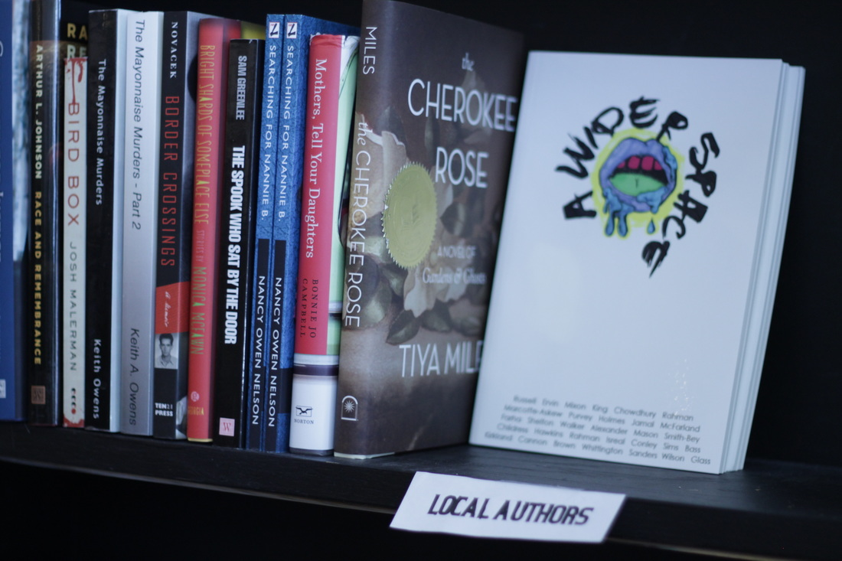
My Project
They were reading Monster and supplementary texts, and looking at “what is freedom?” - I also knew that I needed to add writing.
The students would create for this unit would be a series of writings exploring freedom. Expanding on it. Creating it. Their own definitions of the word.
The strongest of these writings would then be chosen for publication.

Slide 33
“The rest of the world will know how we feel, and our views, and I think that's an important concept of freedom."
- 10th Grade BCHS student

Slide 34
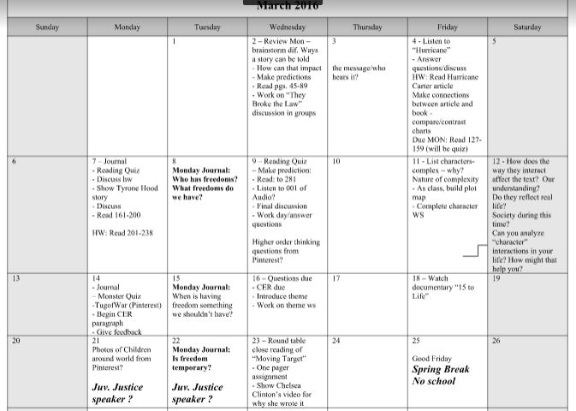
Step 3: Backwards Design
Backward Design is a method of designing educational curriculum by setting your end goals before you figure out the activities and assessments you're going to use.

Slide 35
What I taught:
TEXTS:
Readings:
Monster by Walter Dean Myers
"Hurricane" by Bob Dylan
"Moving Target" by Lemn Sissay
"Stressed Out" by Twenty One Pilots
"We Wear the Mask" by Paul Laurence Dunbar
"Learning to Read" excerpt from The Autobiography of Malcolm X
Prologue Excerpt from I Am Malala
"Poster Children" by Sandra Gail Lambert
"Millions Enslaved throughout the World" article
"Muslim Hijabs" article
It's your world: Get informed, Get inspired & Get going! by Chelsea Clinton
"Create Your Own Freedom or Design Your Own Cage" article
Documentaries:
15 to Life: Kenneth's Story
Crazy Love
Detroit Graduates
Why Reading's Important
Videos
"Know Your Why"
He Named Me Malala clips
'Changing the World Begins with You'
'Detroit Doctor Who Almost Died'
Freedom Writers
Other:
Humans of New York's photographs
Post Secret postcards

Slide 36
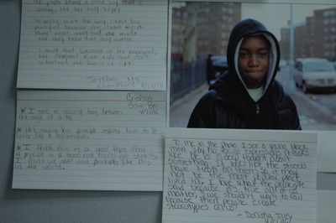
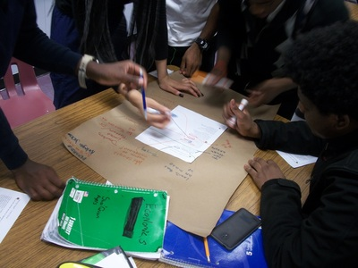
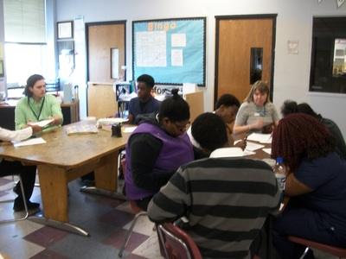
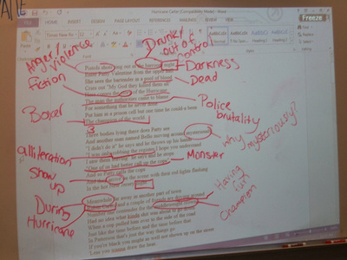

Slide 37
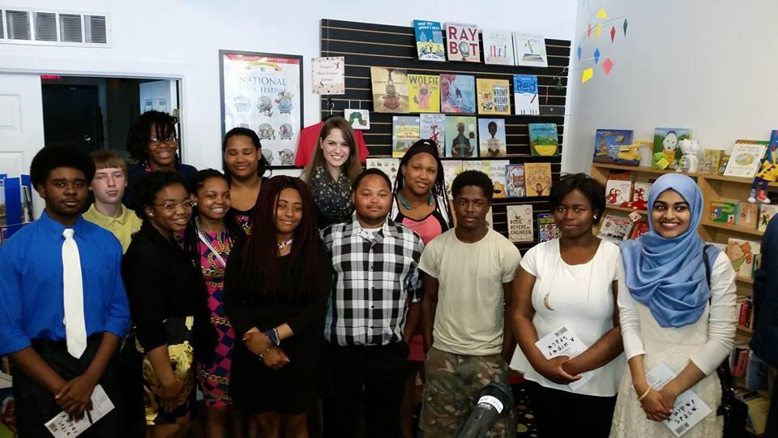

Slide 38
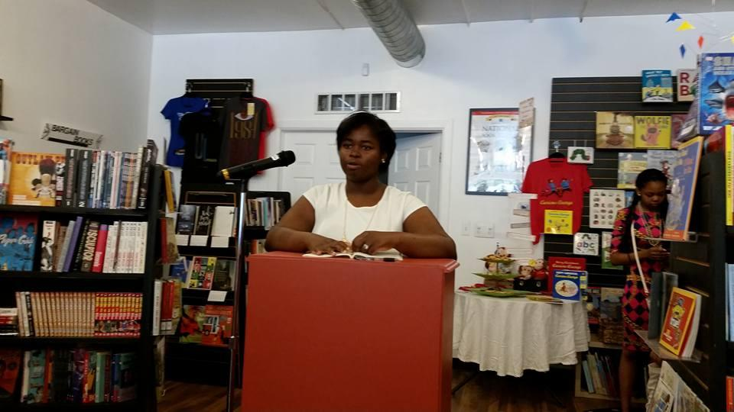
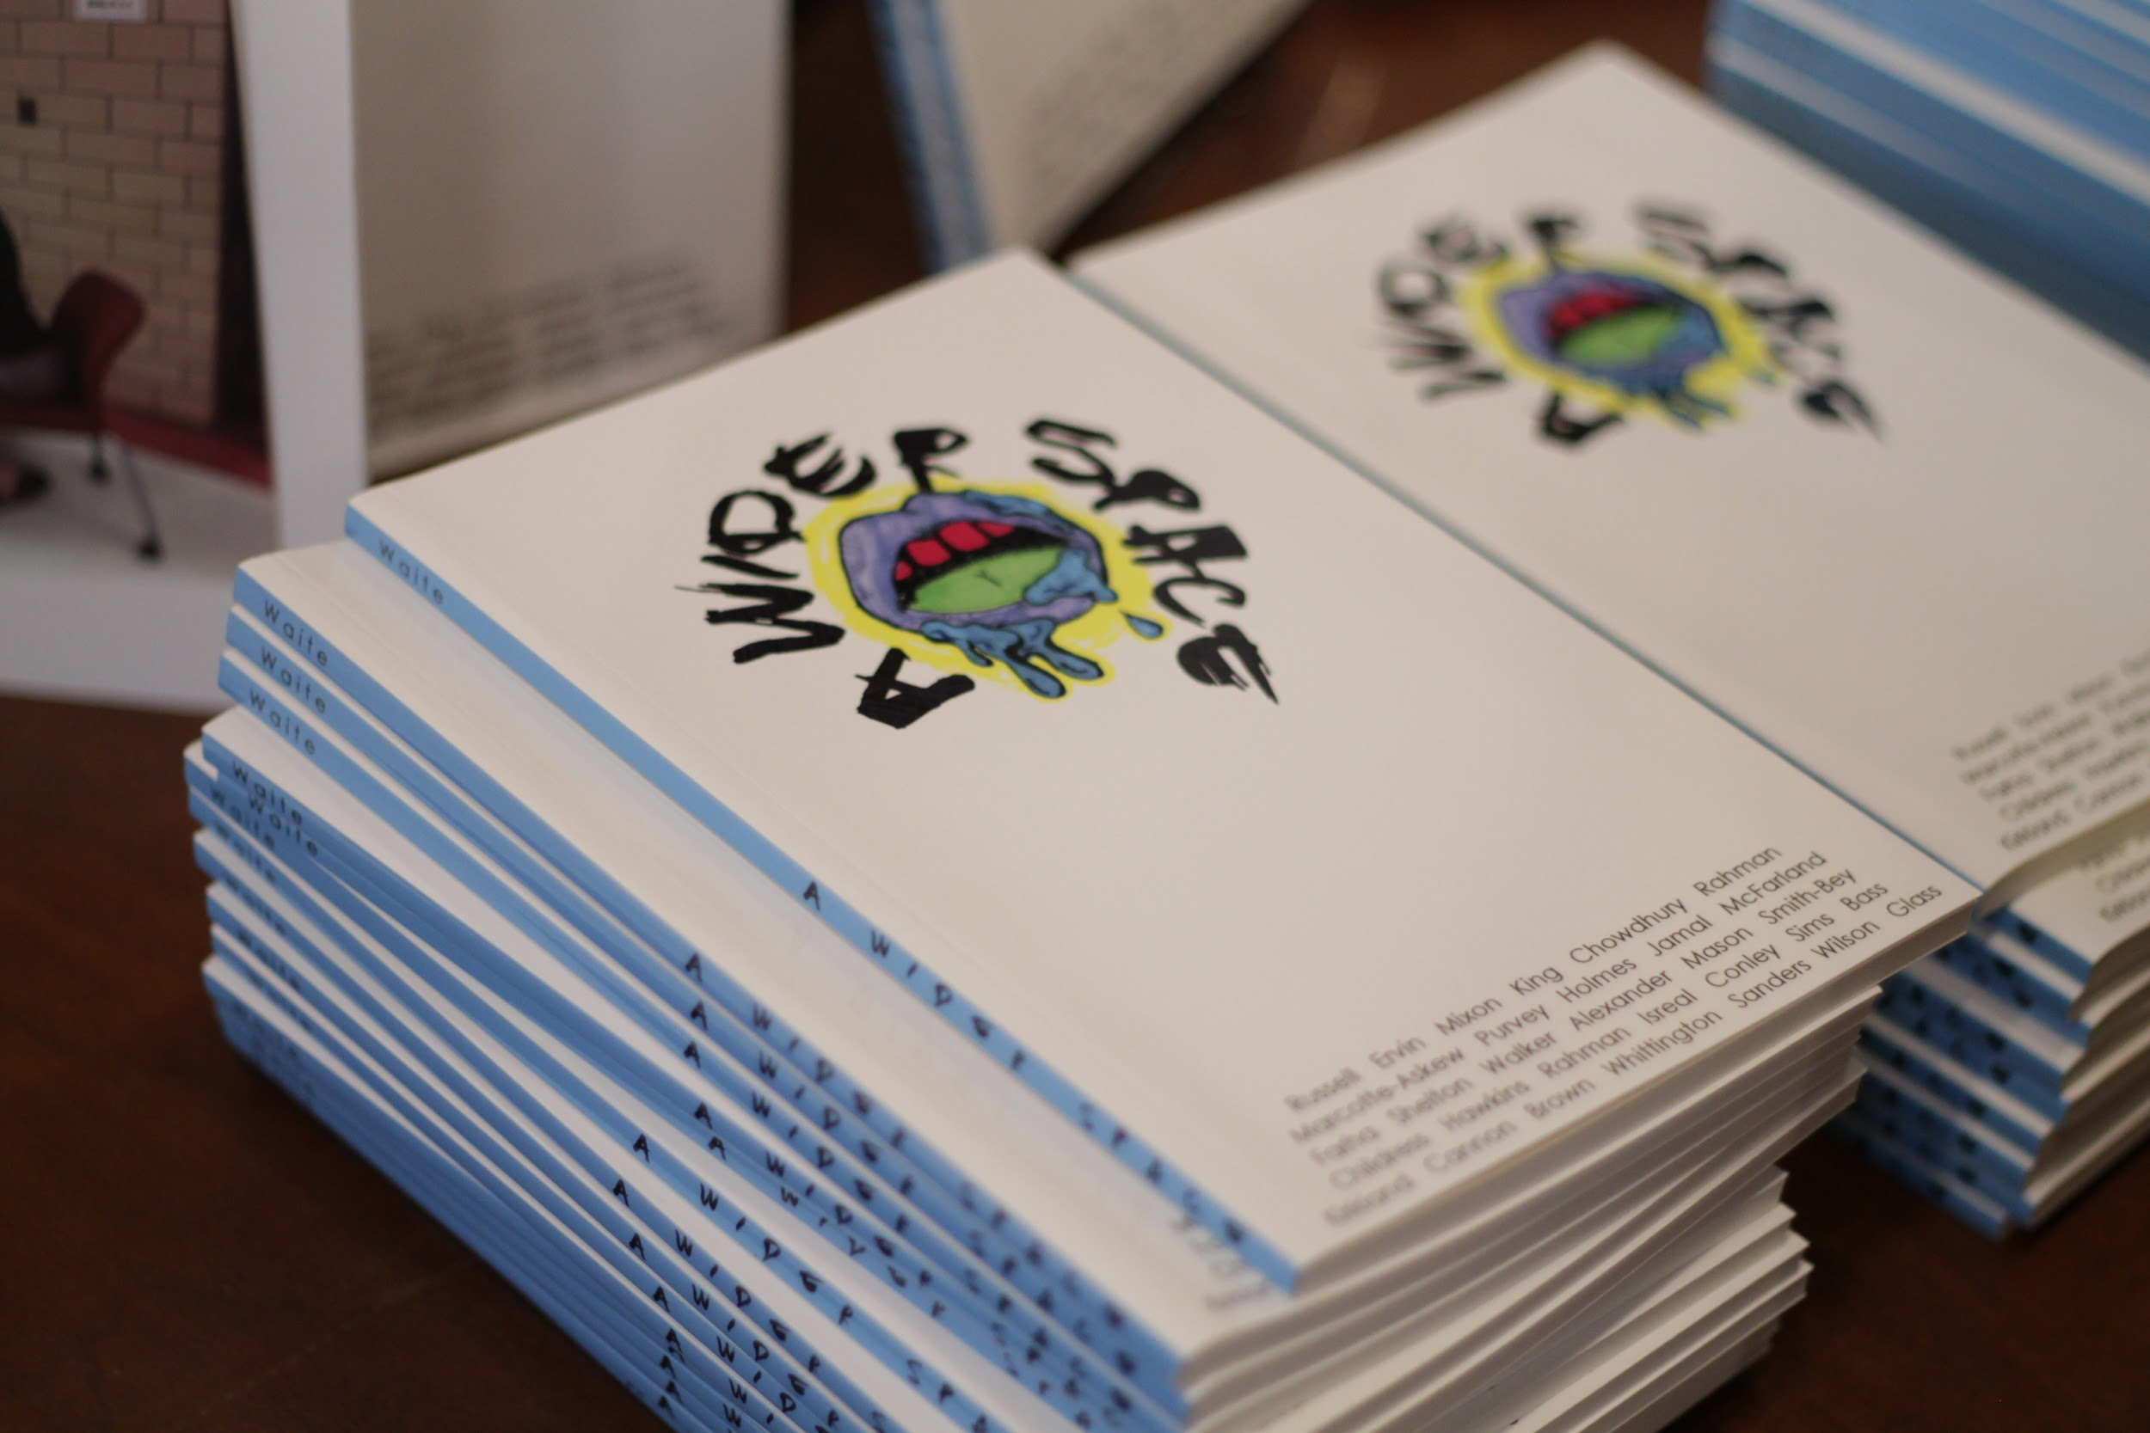
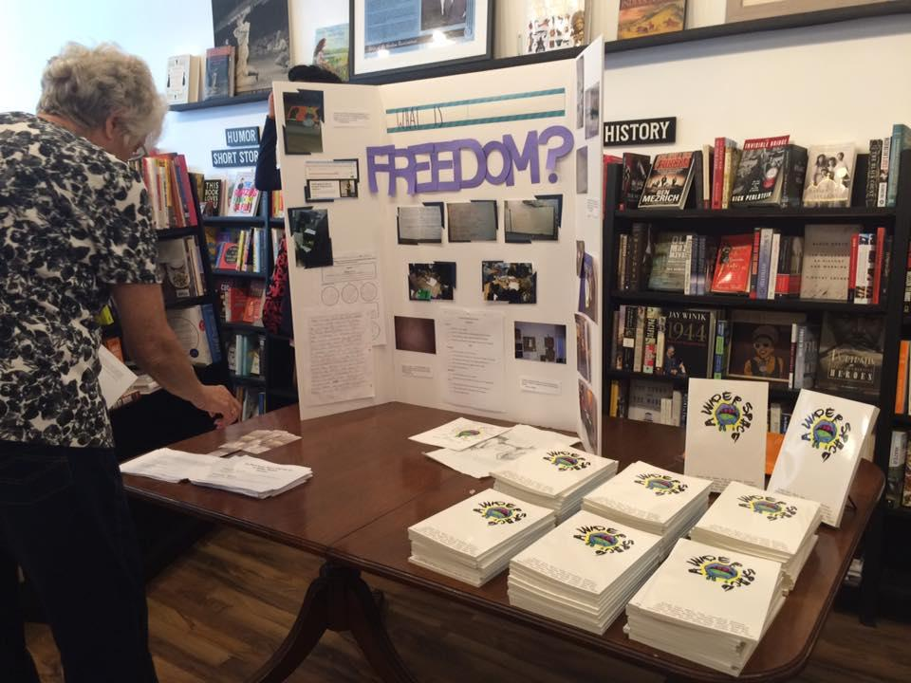

Slide 39
Design Thinking

Slide 40
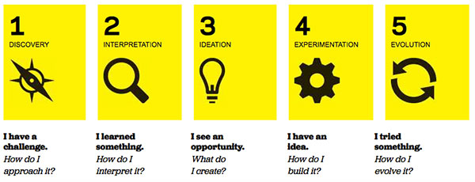
Image from How to Bring Design Thinking to Your School, via edsurge

Slide 42
Discover
Learn
Discuss
Research

Slide 43
The main tenet of design thinking is empathy for the people you're trying to design for.
David M. Kelley

Slide 44
Interpret
Read
Analyze
Write

Slide 45
Ideate

Slide 46
Create

Slide 47
Thank you!
Find our contact info at
mcteauthenticlearning.weebly.com

Slide 48
Credits
Special thanks to all the people who made and released these awesome resources for free:
Presentation template by SlidesCarnival
Photographs by Unsplash

